Slide 1
6주차 논문리뷰 Stock Market Prediction Based on Generative Adversarial Network

Slide 2
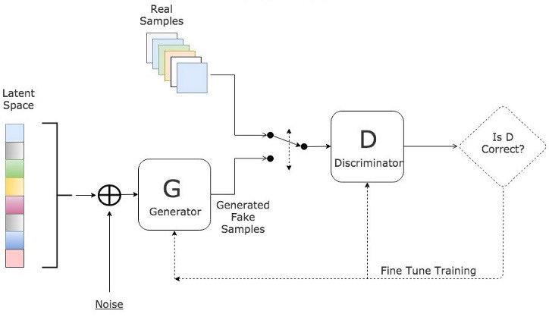
Problem definition
Goal
Find deep learning model to forecast the daily closing price
Some concepts
GAN
Generator - LSTM
Discriminator - MLP

Slide 3
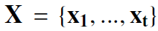
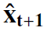
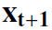
GAN
Generative Adversarial Network
Input feature
Using 7 financial factors to predict future closing price
High price, Low price, Open price, Close price, Volume, Turnover rate, Ma5 (avg. of closing price in past 5 days)
Input date
Predicted / True output

Slide 4
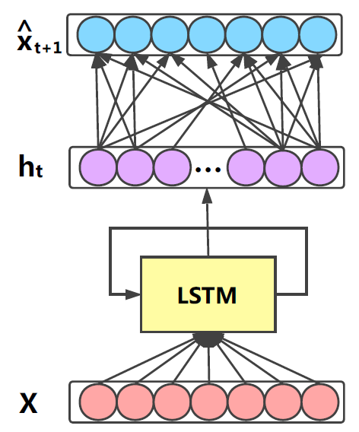
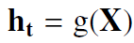
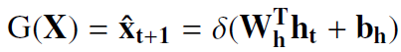
GAN
Generative Adversarial Network
Generator
predicting 7 factors in nest day is that the generator aims to mining the distributions of the real data

Slide 5
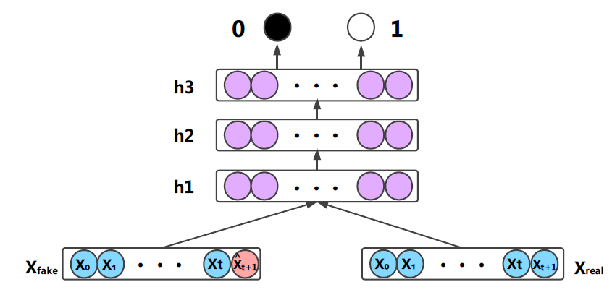
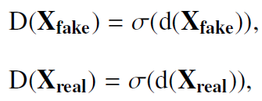
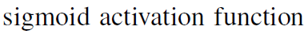
GAN
Generative Adversarial Network
Discriminator
expected output
0 when inputting a fake data
1 when inputting a real data

Slide 6
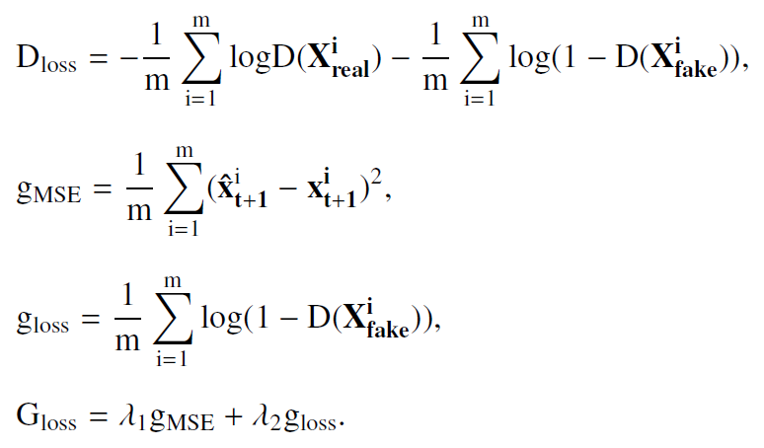
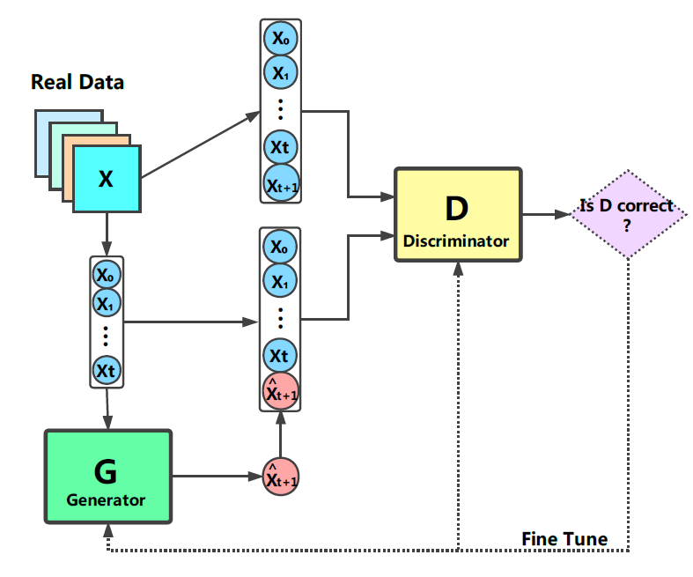
GAN
Generative Adversarial Network
Architecture of GAN

Slide 7
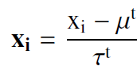
Experiment
Datasets
Configuration of dataset
S&P 500 index, Shanghai Composite index in china
IBM from New York Stock Exchange, Microsoft from NASDAQ
Insurance company of china (PAICC)
All stock data -- from yahoo finance
Select data within last 20 years
almost 5000 pieces of data in each stock
Normalization
Necessary and key point to achieve competitive result (t=5)

Slide 8
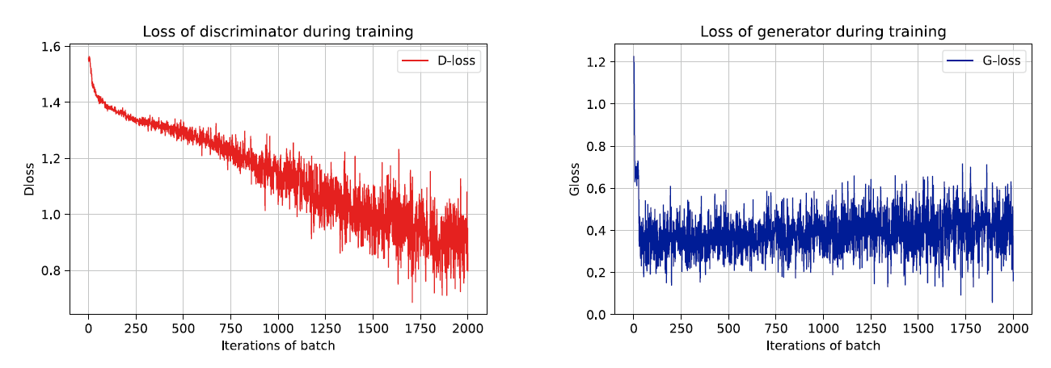
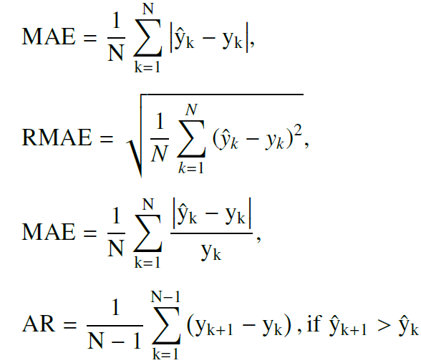
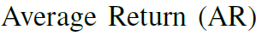
Experiment
Metrics

Slide 9
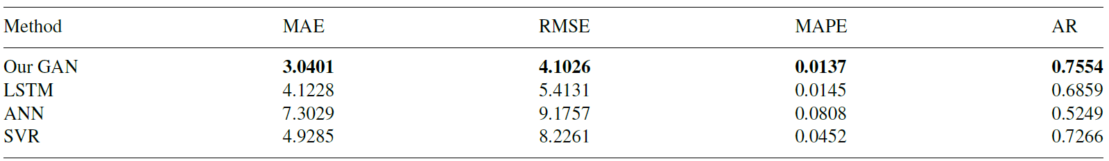
Experiment
Test results
Average evaluation on five stock datasets
Price prediction on PAICC

Slide 10
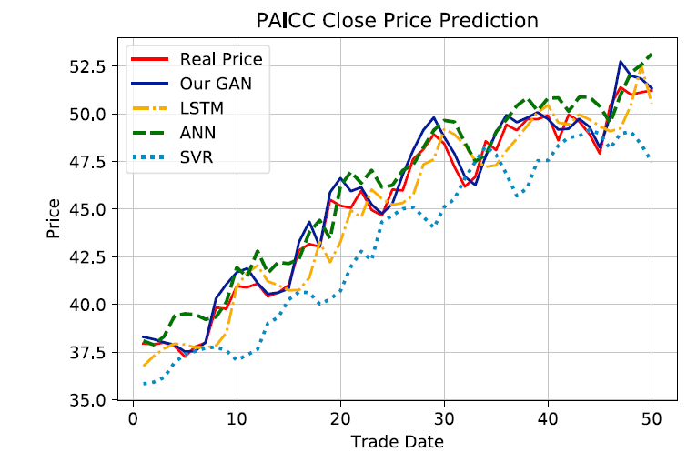
Experiment
Test results
Price prediction on PAICC

Slide 11
Conclusion
Weird things
Convergence of Generator
network architecture
training techniques
Too small results

Slide 12
END

